Slide 1
Reproducibility Principles Data Skills for Empirical Research
Winter, 2020
Notes:
Welcome. We are so happy you’re here.

Slide 2

Reproducibility Matters to...
… journals
… referees
… readers
… your ORI
… your co-authors
… your RAs
… and your future self!
Notes:
(John)

Slide 3
Reproducibility Challenges
Reproducibility is hard because collaborating is hard.
Did someone on the team…
... exclude observations based on the agreed upon criteria ?
… put the most recent version of Table 4a. in your paper?
… rely on a program or server that you no longer have access to?
... accidentally overwrite a file?
... intentionally overwrite a file?
... quit and leave you up the creek?
...
(These problems go beyond research projects.)
Notes:
(John) Return to this theme of collaboration. Coordinating the actions of people is an inherently complicated problem. This is true in many lines of work, and it’s also true outside of work. If collaboration were easy, schools like Kellogg would not exist, and most of you would not have dissertation topics. Thankfully, many of the same principles about managing teams can help you think about managing code or data.

Slide 4
Ponder This…
How easily could you replicate calculations you did from an undergrad class?
What are you going to do with your work when you move on to another school?
Notes:
This is a discussion opportunity.

Slide 5
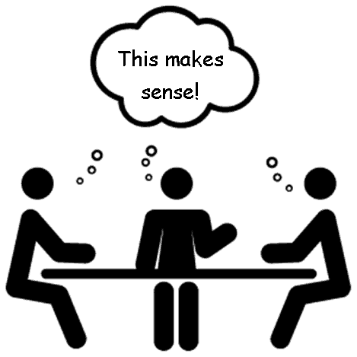
Good Collaboration Practices
Clear goals, roles, and expectations.
Transparency: What is done, not done.
Keep good records.
Automate to reduce your human problems.
Notes:
(John) Thankfully, this building is full of people with ideas for why some collaborations work, others fail. We can use that knowledge to apply to our problem of research collaboration.

Slide 6
Directory Structures
This was a real RS directory with code & data that monitors load on KLC.
Where would you look to find measures of the load for each user last Monday?
active_netids.txt
active_usernames.txt
daily_email.sh
email_lookup.py
emails_of_active_users.sh
loadavg.gnuplot
loadavg_history.klc01.txt
loadavg_history.klc02.txt
loadavg_history.klc03.txt
loadavg_history.klc04.txt
loadavg_history.klc05.txt
loadavg.png
monitor_load.sh
netids_of_active_users.sh
renice/
users_history.klc01.txt
users_history.klc02.txt
users_history.klc03.txt
users_history.klc04.txt
users_history.klc05.txt
vmstat.gnuplot
vmstat_history.klc01.txt
vmstat_history.klc02.txt
vmstat_history.klc03.txt
vmstat_history.klc04.txt
vmstat_history.klc05.txt
vmstat.png
Notes:
(John)

Slide 7
Directory Structures
Suggestion: Use intuitive directory and file naming conventions.
renice/
README.txt
inputs/
outputs/
programs/
run_logs/
versions_old/
programs/
1_get_ps.py
2a_sum_users.py
2b_sum_load.py
3_make_graphs.py
4_send_email.py
RUN_ALL_PROGRAMS.sh
Notes:
(John) Conventions reduce cognitive load.

Slide 8
Automation
Manifesto: Automate everything that can be automated!
Notes:
DISCUSSION: Who here abides this principle?

Slide 9
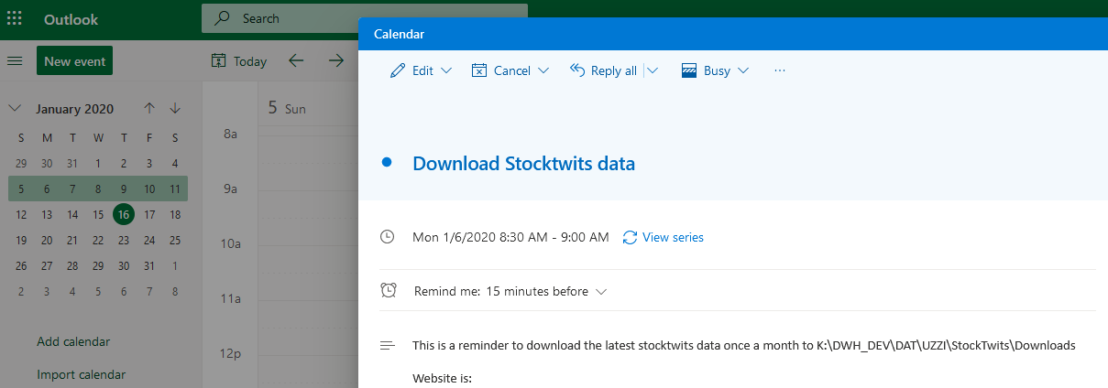
Do You Have Tasks Like This?
Notes:
DISCUSSION: Who here abides this principle?

Slide 10
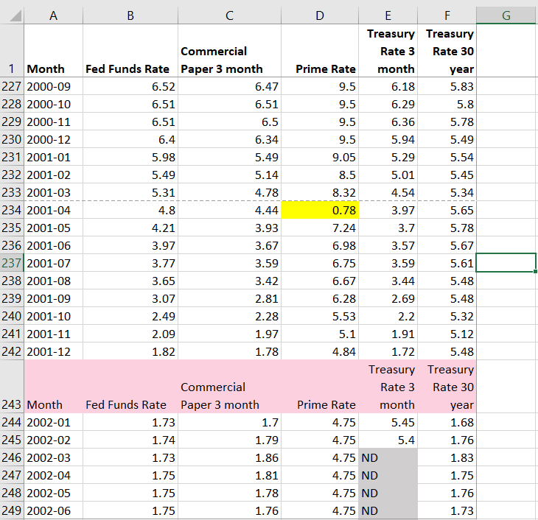
What Would You Do?
It would be easy to fix these problems one time in Excel.
Should you?
Notes:
(John)

Slide 11
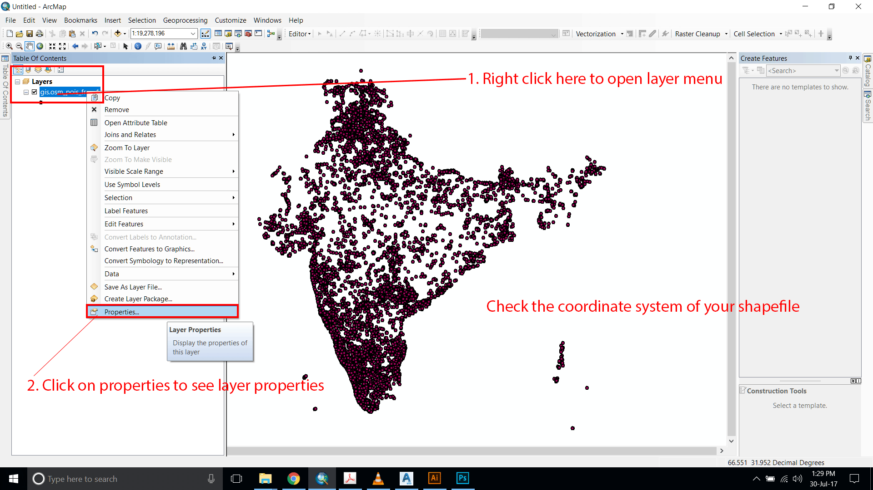
What Would You Do?
From a tutorial on using ArcGIS in point-and-click style…
Is this action easy to reproduce?

Slide 12
Abstraction
Minimize redundancy
Introduce fewer errors, inconsistencies
Easier to re-use code across applications
Improve readability (self-documenting)
Notes:
DISCUSSION: What does “abstraction” mean?
Why would you

Slide 13
Evaluate sleeper.py
import time
import random
# Set seed for random number generator
random.seed(a=5911575)
# Path to input file
infile = 'clean_tickers.txt'
with open(infile) as ticks:
tick = ticks.readline()
tick = tick.replace('\n', '')
while tick:
url = "https://finance.yahoo.com/quote/" + tick
url += "/sustainability"
print (url, "started at" , time.ctime())
rand = random.randint(2,5)
time.sleep(rand)
Notes:
John: make an example

Slide 14
Documentation
Document Everything!
Only document what you are willing to maintain.
Watch out for multiple “systems of record.”
Notes:
Ambreen

Slide 15
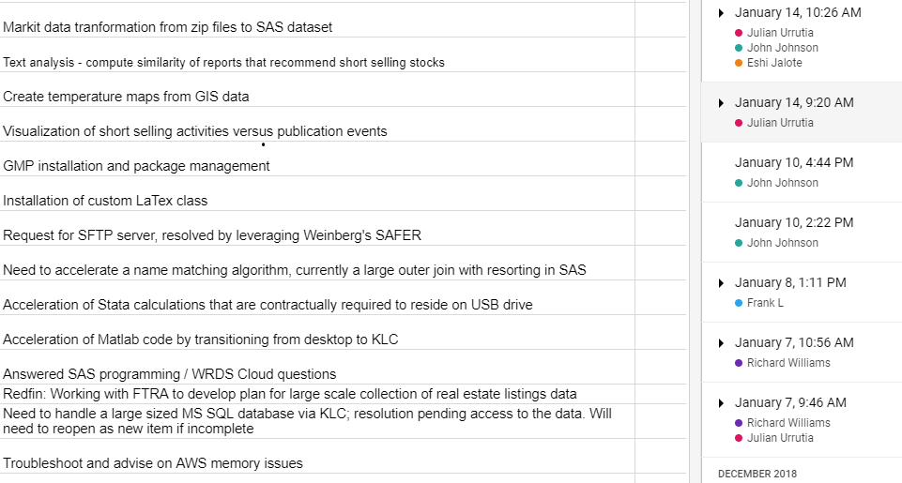
Version Control
Example of a spreadsheet shared and used by many people
Notes:
You have all worked with version control whether you realize it or not. And it has probably saved you.

Slide 16
Version Control in Scientific Computing
Manage Code with Tools like git
...save, revert to earlier versions
...develop new code on independent branches
...track issues, bugs, fixes, and who made them
Software Packages
Python: conda, virtualenv
R: Packrat
Environments
Docker
Singularity (KLC/Quest)
Caution: All tools require human judgment to be used well.
Notes:
(Richard) Touch on themes of TRANSPARENCY. KEEPING GOOD RECORDS.
- Keep a master copy/branch that only contains functional code
- Make draft branches for building different features
- When to commit a change to a repository
break your code down into small discrete functional units
commit changes after writing and testing each unit

Slide 17
You Can't Reproduce Results Unless...
Reproducing results implies you can produce them.
Debugging Advice
Break problem into discrete pieces
Test, test, test… before moving on
anticipate errors, handle them
print statements
save intermediate outputs
Notes:
Ambreen

